Slide 1

Dynamic Violin Fingerboard
Team 93
Adrian Ignaci, Kamil Waz, Sophia Wilhelm

Slide 2
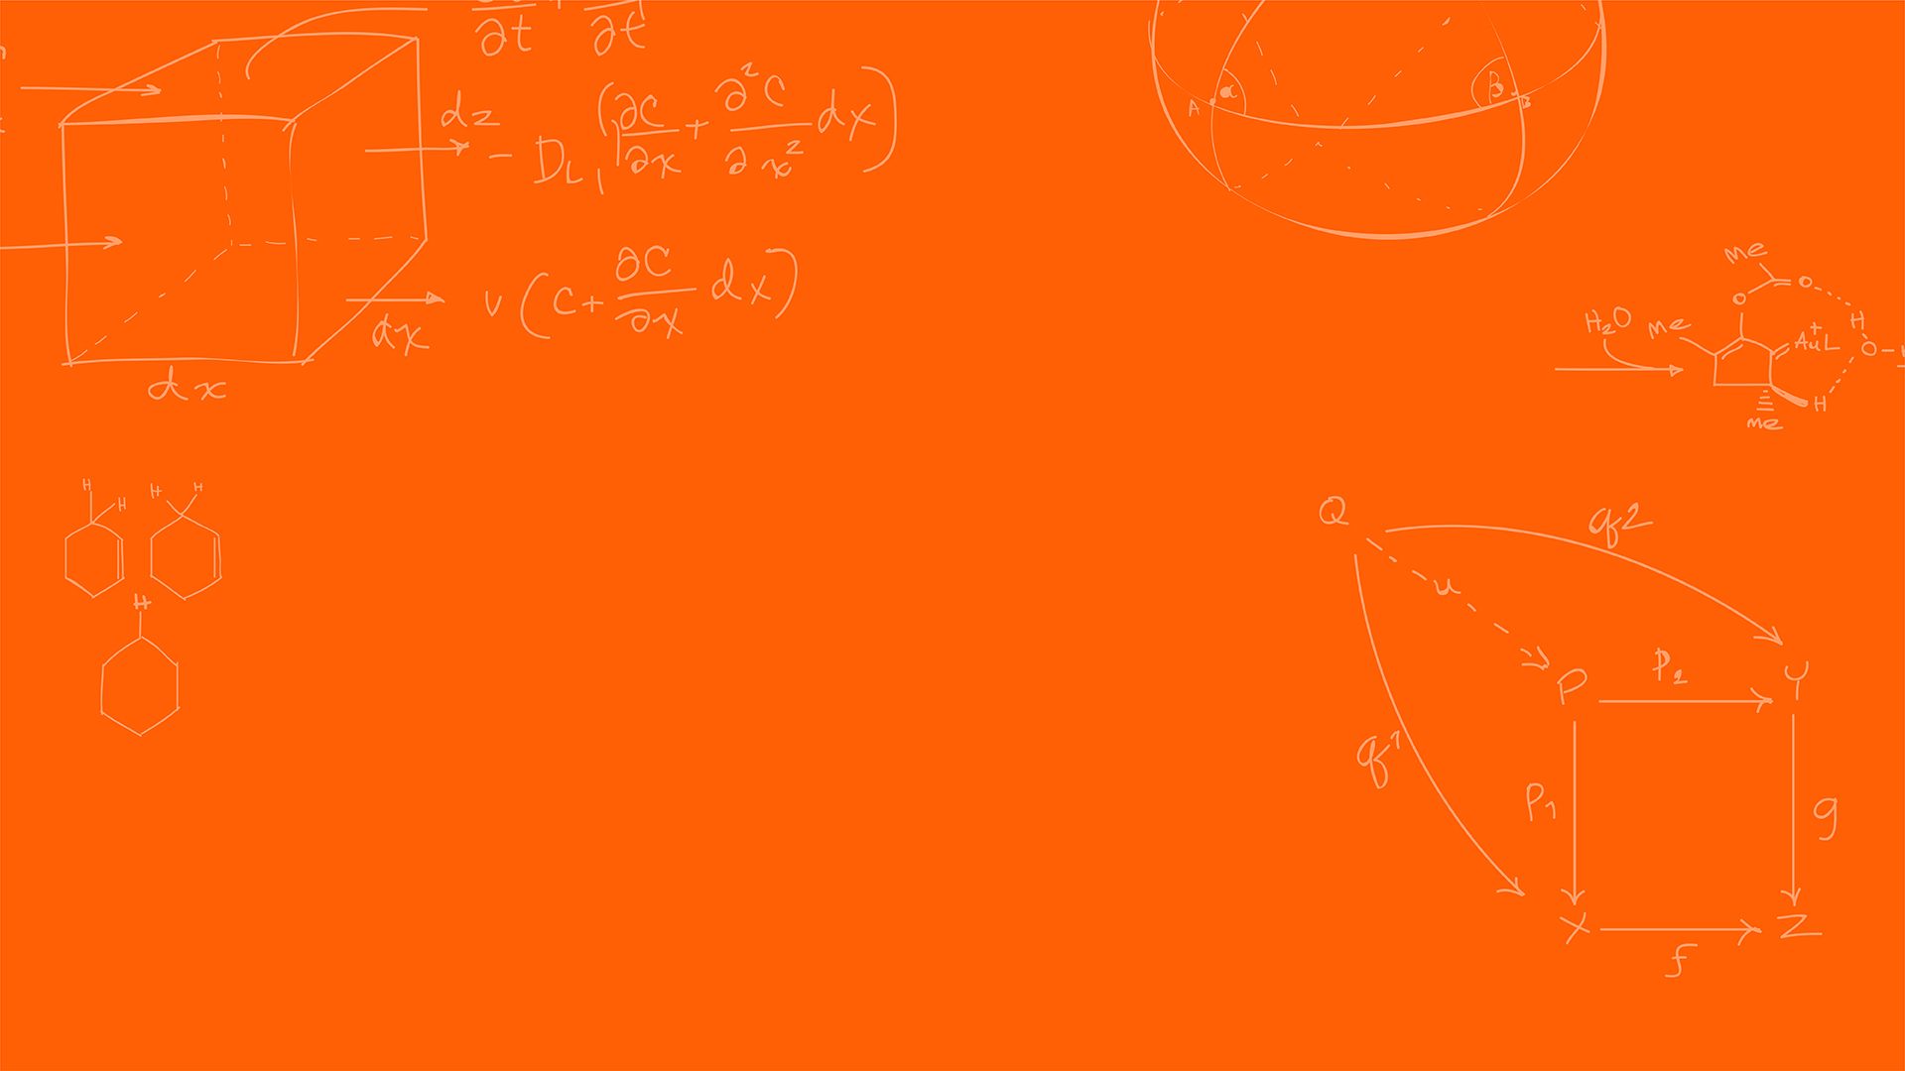
Introduction
ELECTRICAL & COMPUTER ENGINEERING
GRAINGER ENGINEERING

Slide 3

Problem
Objective: Learn to Play Violin
Challenges:
Costly Lessons
Lack of Feedback
ELECTRICAL & COMPUTER ENGINEERING
GRAINGER ENGINEERING

Slide 4
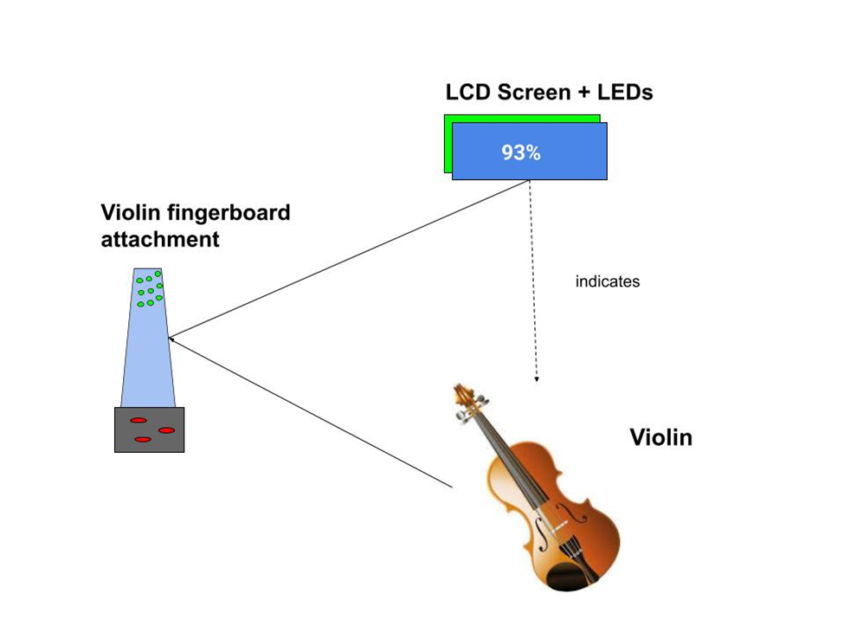
Solution
Main Unit:
Upload Songs
Guide User through Piece
Check Accuracy
Fingerboard Attachment:
LEDs
Potentiometer
ELECTRICAL & COMPUTER ENGINEERING
GRAINGER ENGINEERING

Slide 5
Uniqueness
The project is similar to some available products (such as light-up keyboards), but is unique due to
User uploaded pieces
Analog functionality
Detachability
Swappable neck/board possibilities
ELECTRICAL & COMPUTER ENGINEERING
GRAINGER ENGINEERING

Slide 6
Design
ELECTRICAL & COMPUTER ENGINEERING
GRAINGER ENGINEERING

Slide 7
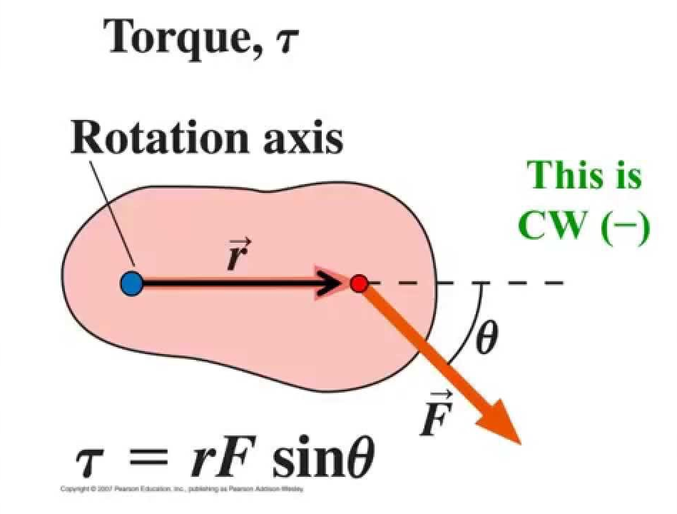
Hardware
Special Considerations:
Small clearance of violin strings
Non-uniform note spacing
Non-destructive (detachable)
Curved fingerboard surface
Excessive weight
Assume device point mass
Scroll end -> 2.646 N (0.6lbf)
Under body
ELECTRICAL & COMPUTER ENGINEERING
GRAINGER ENGINEERING

Slide 8
ESP32-WROOM-32 Microcontroller
Lives in both input and output systems:
Processes location information and maps it to display values
Pros:
Very flexible/adaptable
Lots of GPIO
Wireless functionality
Some members have used it
Cons:
More difficult hardware design
Requires additional hardware to make viable
ELECTRICAL & COMPUTER ENGINEERING
GRAINGER ENGINEERING

Slide 9
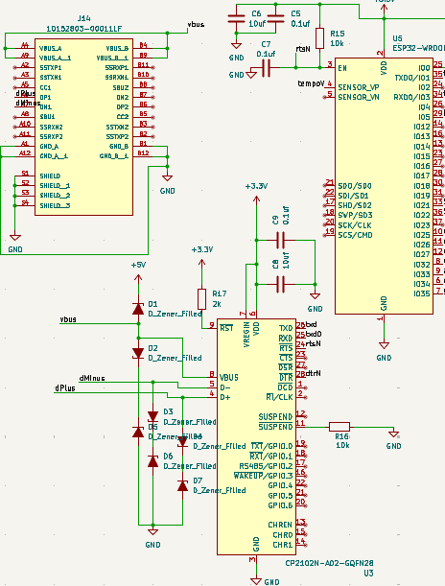
ESP32 with Associated Extra Hardware
ELECTRICAL & COMPUTER ENGINEERING
GRAINGER ENGINEERING

Slide 10
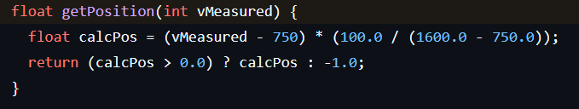
Input System
Consists of:
Membrane potentiometer touch sensors (they can float!)
SpectraSymbol SP-L-0100-103-3-ST
ESP32 (For the Web Server)
Web Server replaced USB functionality
ELECTRICAL & COMPUTER ENGINEERING
GRAINGER ENGINEERING

Slide 11
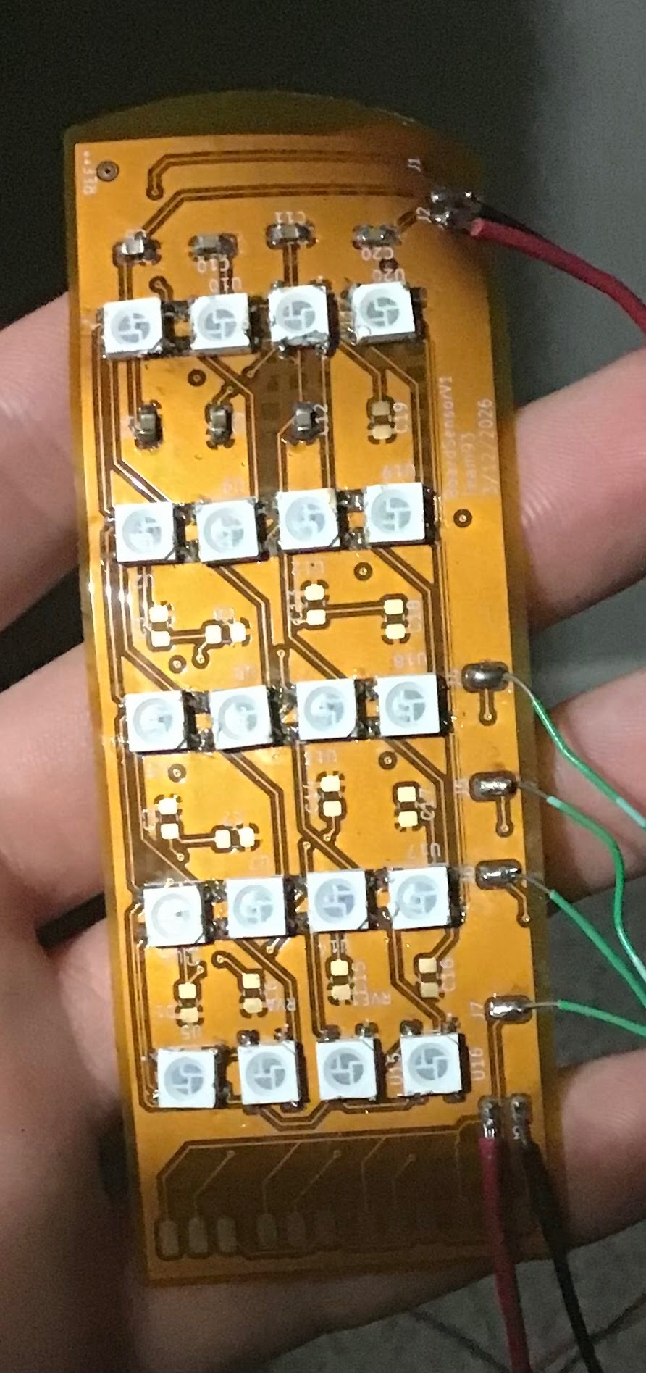
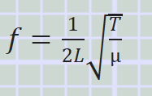
Output System
LCD Screen (16x2)
Individually Addressable LEDs (FZ2812-5050)
Must be specially spaced to properly display target locations
ELECTRICAL & COMPUTER ENGINEERING
GRAINGER ENGINEERING

Slide 12
String Placements (mm)
 | G string | D String | A String | E String
Low 1st | 18 | 18 | 18 | 0
1st Finger | 36 | 36 | 36 | 18
2nd Finger | 68 | 52 | 52 | 52
High 2nd | 83 | 68 | 68 | 68
3rd Finger | 83 | 83 | 83 | 83
ELECTRICAL & COMPUTER ENGINEERING
GRAINGER ENGINEERING

Slide 13
Power System
ESP32 can hit peaks of 500mA when running a web server!
Assume all LEDs and LCD have a separate current source
We must isolate the 5V and 3.3V lines:
Each has a voltage regulator rated for 800mA
Shut off web server when not in use
Powered by 5000mA battery pack
ELECTRICAL & COMPUTER ENGINEERING
GRAINGER ENGINEERING

Slide 14
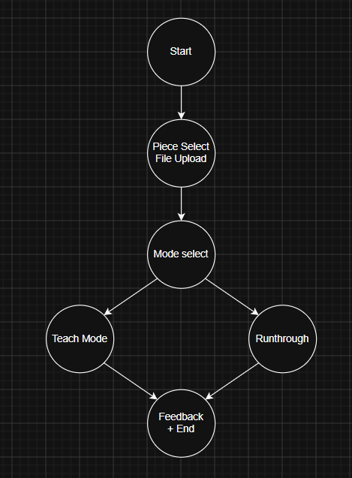
High-Level Function
The FSM on the left is a basic representation of the software structure and use order of the product.
Note how each state contains multiple unique behaviors as opposed to a single change.
IMAGE
ELECTRICAL & COMPUTER ENGINEERING
GRAINGER ENGINEERING

Slide 15
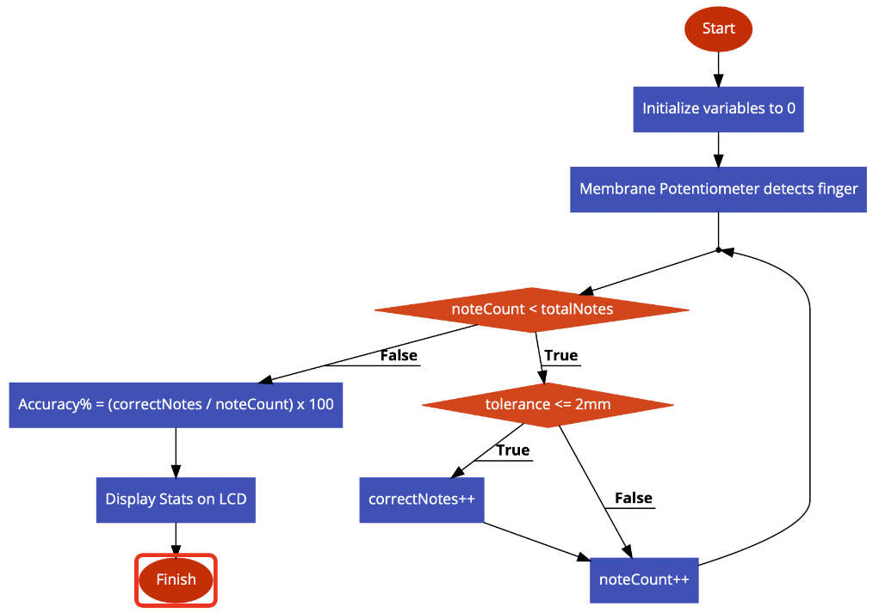
Software Design
ELECTRICAL & COMPUTER ENGINEERING
GRAINGER ENGINEERING

Slide 16
Verification
ELECTRICAL & COMPUTER ENGINEERING
GRAINGER ENGINEERING

Slide 17
Requirements/Verification: Output Subsystem
Requirements | Verification
Microcontroller <--> LEDs latency self-consistent within a variation tolerance of 7ms +- 1ms | Use oscilloscope to measure time between subsequent data packets
ELECTRICAL & COMPUTER ENGINEERING
GRAINGER ENGINEERING

Slide 18
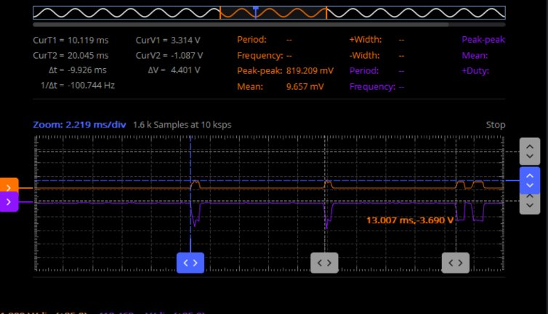
0'd at first packet Average of ~10ms latency with a deviation of 1ms.
Latency Results
Packet 1: 0 ms
Packet 2: 10.119 ms
Packet 3: 20.045 ms
ELECTRICAL & COMPUTER ENGINEERING
GRAINGER ENGINEERING

Slide 19
Requirements/Verification: Input Subsystem
Requirements | Verification
Web server can upload a file of up to 1 MB in size within 10 seconds | Use a network analysis tool to measure the delay between sending a file and receiving a response from the server
ELECTRICAL & COMPUTER ENGINEERING
GRAINGER ENGINEERING

Slide 20
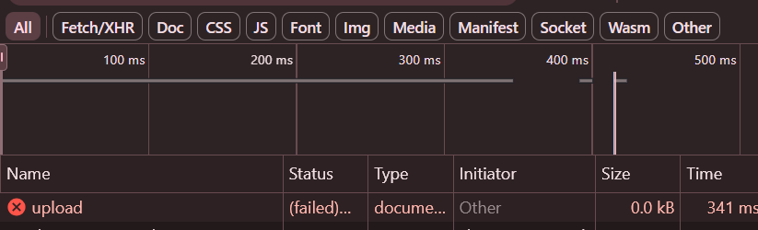
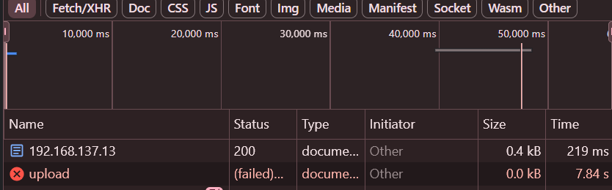
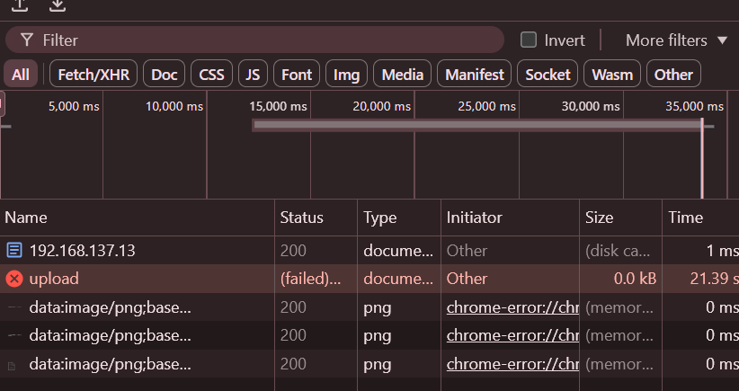
Upload of: Musette (1KB)
Upload of: IPR Test Document (1 MB)
IMAGE
Upload of: Blank 1098 Form (1.2 MB)
ELECTRICAL & COMPUTER ENGINEERING
GRAINGER ENGINEERING

Slide 21
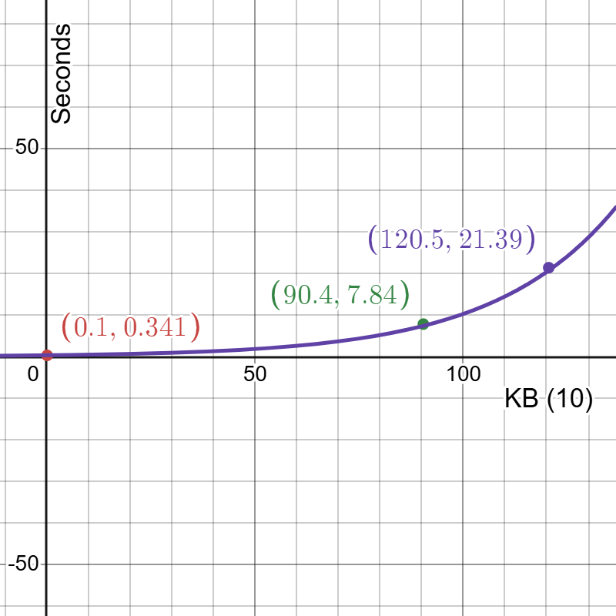
Upload time grows: y=0.34e^{0.0341x}
Upload Time Equation
ELECTRICAL & COMPUTER ENGINEERING
GRAINGER ENGINEERING

Slide 22
Requirements/Verification: Input Subsystem
Requirements | Verification
Detect user finger placement within 2mm +/- 0.1mm | Mark correct positions with tape; measure deviation from tape when correct note detected
ELECTRICAL & COMPUTER ENGINEERING
GRAINGER ENGINEERING

Slide 23
Requirements/Verification: Power Subsystem
Requirements | Verification
Consistent 3.3V +/- 5% voltage, 250mA current to the ESP32 | Use multimeter to measure voltage drop ESP --> GND
Consistent 5V +/- 5% voltage, 500mA current to LEDs, LCD | Use multimeter to measure voltage drop LEDs, LCD --> GND
ELECTRICAL & COMPUTER ENGINEERING
GRAINGER ENGINEERING

Slide 24
Challenges and Failures: Power Subsystem
(Individual test)
Power bank output 6.4 volts (>5)
3.3 voltage regulator output 4.2 (>3.3)
(Multi-system test)
Power button pin, ground at ground of 3.3 voltage regulator
Vin got 1.36, and Vout got 0
ELECTRICAL & COMPUTER ENGINEERING
GRAINGER ENGINEERING

Slide 25
Challenges and Failures: Flexible PCB
Pwr/Gnd pads ripped off (WEAK)
LED spacing sideways (between strings) very tight
Inner LEDs not getting sufficient power
Possible bridging
Not enough capacitors; needed:
specific value
*surface mount*
lot of them (~20)
ELECTRICAL & COMPUTER ENGINEERING
GRAINGER ENGINEERING

Slide 26
Conclusion
ELECTRICAL & COMPUTER ENGINEERING
GRAINGER ENGINEERING

Slide 27
Future Improvements
More constructive feedback for the user on the LCD display
Implementing optical recognition software to read sheet music
Cleaner exterior (housing, detachable system)
Slimmer flexible PCB (thinner LEDs)
USB option
Detachable sensor arrays and software support for more instruments!
ELECTRICAL & COMPUTER ENGINEERING
GRAINGER ENGINEERING

Slide 28
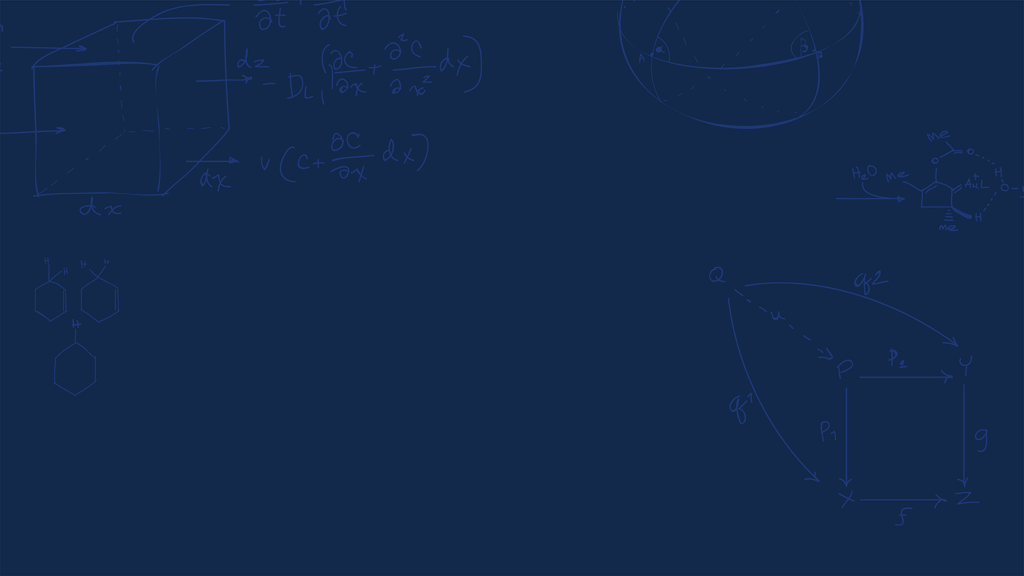
Thank You
Questions, Comments, Concerns?
ELECTRICAL & COMPUTER ENGINEERING
GRAINGER ENGINEERING

